Slide 1
INTRODUCTION TO NODE JS
Node.js was created by SAHIL SHARMA.

Slide 2
What is node.js ?
Node.js is a javaScript runtime built on chrome’s v8 javascript engine for executing javascript code on server-side. Node.js user event-driven , nonblocking I/O made that makes it lightweight and efficient.

Slide 3
Why use node.js ?
Node’s goal is to provide an easy way to build scalable network program

Slide 4
What is unique about node.js
JavaScript used in client-side but node.js puts the JavaScript on server-side thus making communication between client and server will happen in same language
Servers are normally thread based but Node.JS is “Event” based. Node.JS serves each request in a Evented loop that can able to handle simultaneous requests.

Slide 5
What can we build on node.js
REST API & BACKEND APPLICATION
REAL TIME SERVICES(CHAT,GAME ,ETC)
BLOGS,SOCIAL APPLICATION
UTILITIES & TOOLS
ANYTHING THAT IS NOT CPU INTENSIVE

Slide 6
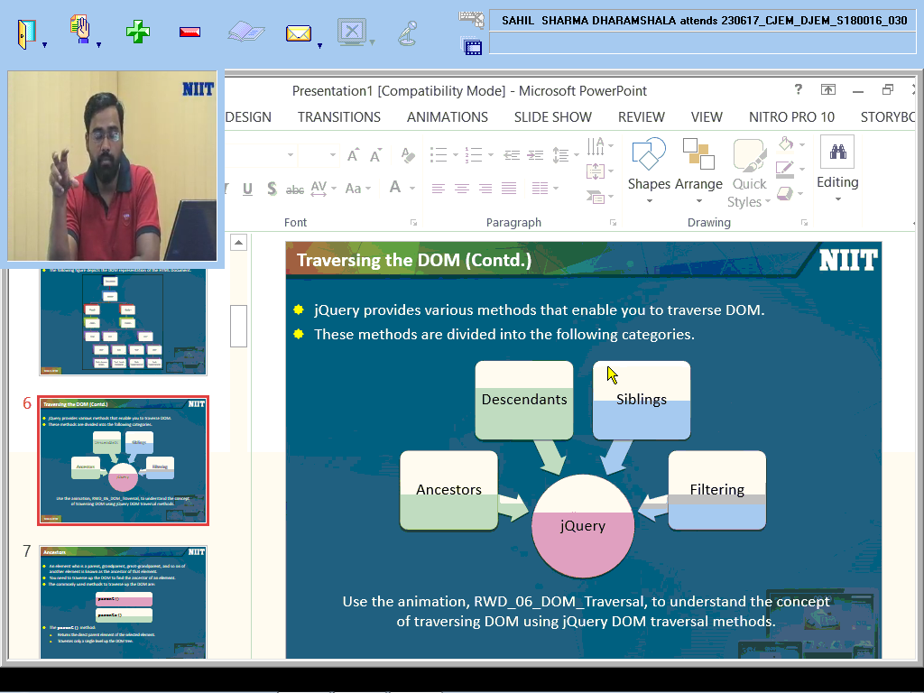
TRAVERSING THE DOM

Slide 7
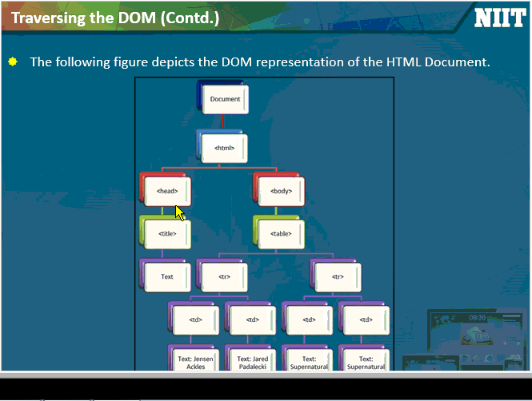

Slide 8
THANK YOU

